Slide 1
Gradient Descent and Optimization algorithms

Slide 2
Situation as of now
Model ---> Linear regression, Logistic regression etc
Model parameters - (weights and biases)
Cost function ---> Cross entropy loss , Mean Square error loss

Slide 3
Q. What is optimization algorithm and what are we trying to optimize (w.r.t machine learning)?

Slide 4
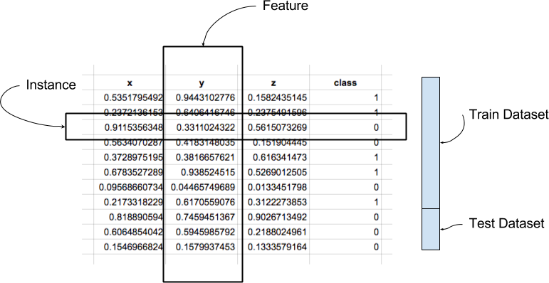
Dataset terms

Slide 5
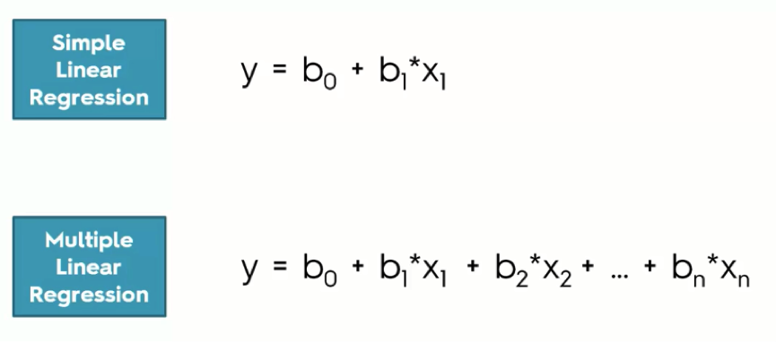
Linear Regression

Slide 6
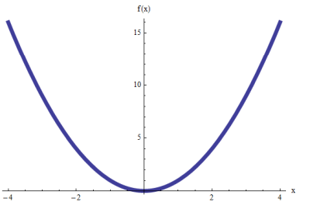
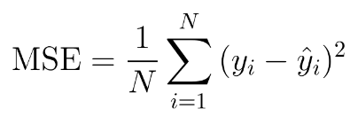
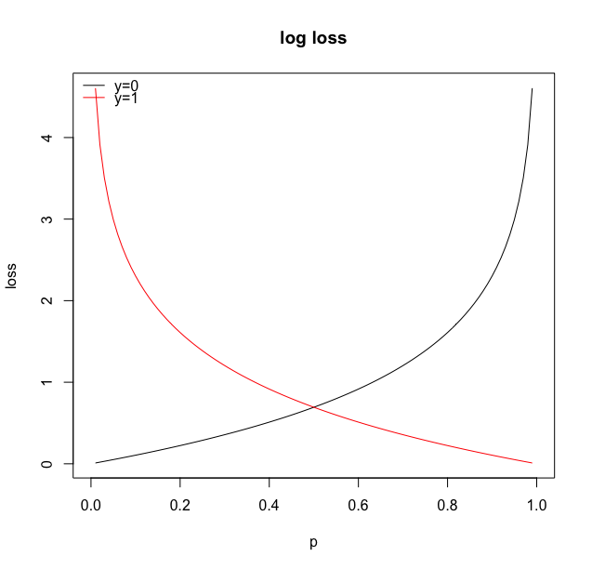
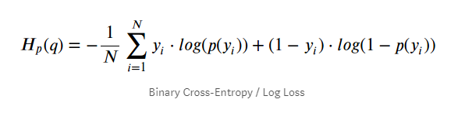
Loss Functions

Slide 7
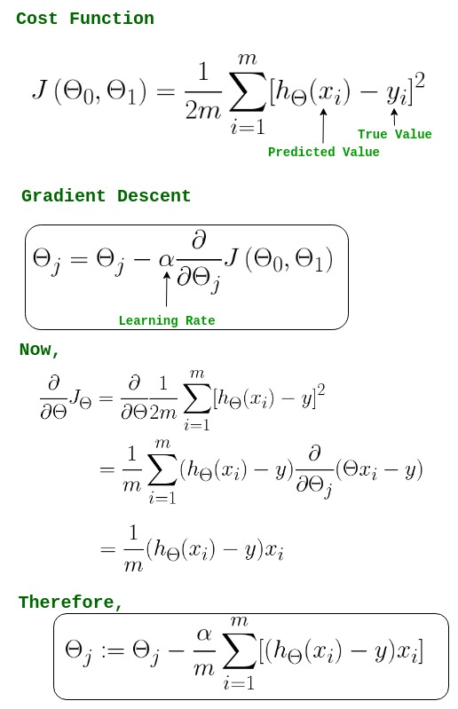
Gradient Descent
M = number of datapoints in dataset
J_theta = loss
Alpha = learning rate

Slide 8


Slide 9
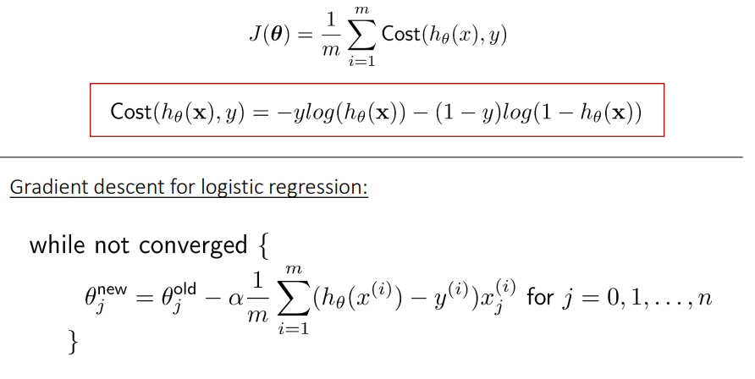
Gradient Descent- Logistic Regression

Slide 10
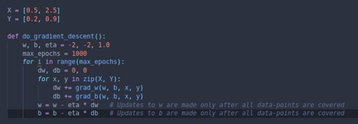
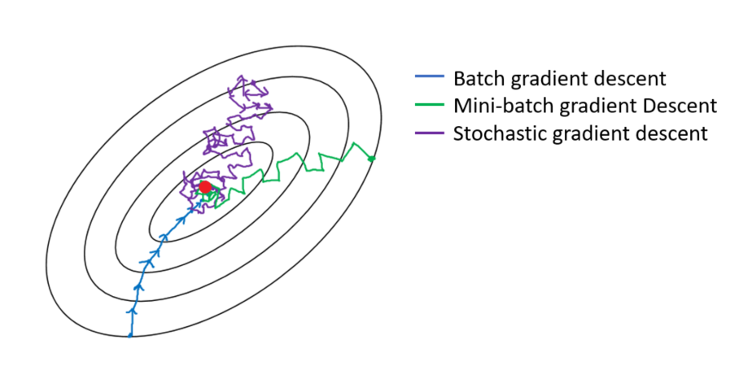
Gradient descent - Pseudocode
for every epoch
for every data point in dataset
loss_total = loss_total + loss_i
calculate gradient
update weights

Slide 11
Gradient Descent ……...
we can see that we make one update(w,b) for one pass/epoch over the data
It can be exemplified as follows
a. Consider a training set with 1 million data points
b. With Gradient Descent, we calculate the derivatives for each of these points
c. Once we’re done, we update the parameters
d. Thus, we pass over all 1 million points to make a single update to w & b
we can choose to make an approximation based on looking at a smaller portion(batch) of the data points instead of analysing the whole dataset each time.

Slide 12
Disadvantages of GD
It is very slow in the areas where slope is less
Take a lot of computation and time to take a single step on large datasets

Slide 13
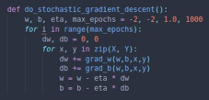
Stochastic Gradient Descent
for every epoch
for every data point in dataset
loss_total = loss_total + loss_i
calculate gradient
update weights

Slide 14
Mini Batch Gradient Descent
for every epoch
for every data point in dataset
loss_total = loss_total + loss_i
Sum up gradients
if i%batch_size ==0
update weights

Slide 15
……………..
The oscillations are due to redirection after every point, as every point behaves as
an individual greedy entity influencing w & b, thus leading to fluctuations right from
the start.
1. Some of the advantages of Stochastic GD are
a. Quicker updates
b. Many updates in one pass of the data
2. Some of the disadvantages of Stochastic GD are
a. Approximate(stochastic) gradient
b. Almost like tossing a coin once and computing P(heads)

Slide 16
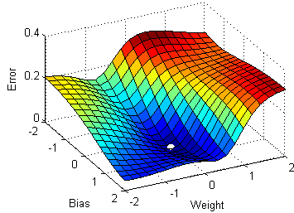
Gradient Descent - (good for higher gradients )
Work around
Increase learning rate
Multiple times random initialization of weights
Momentum based Gradient Descent

Slide 17
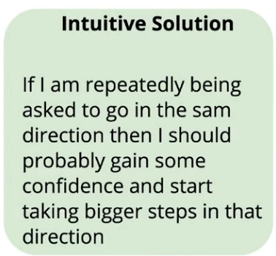
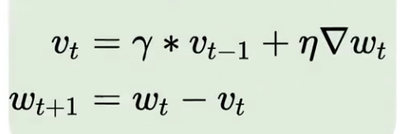
Momentum Based Gradient Descent

Slide 18
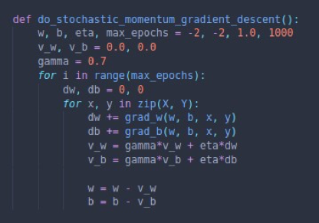
Momentum GD - Pseudocode

Slide 19
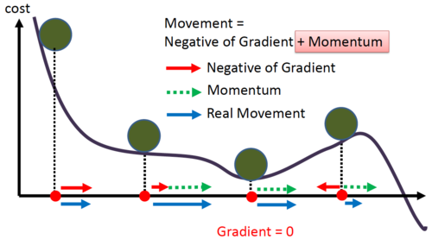

Slide 20
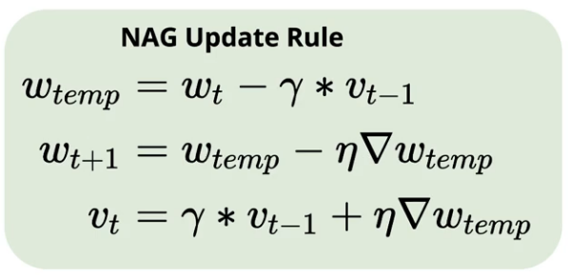
Nesterov accelerated GD - NAG
Works on same principle as momentum
based gradient descent with slight upgradation

Slide 21
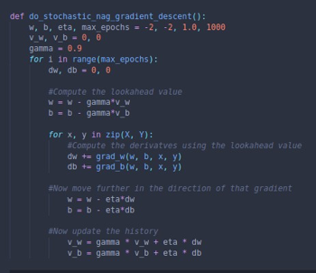
NAG - Pseudocode

Slide 22
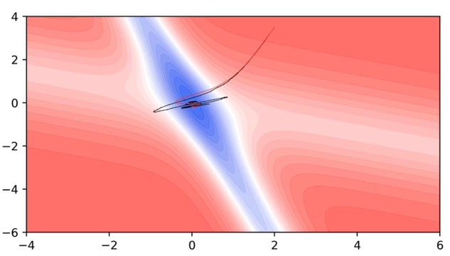

Slide 23
Adaptive Learning rate

Slide 24
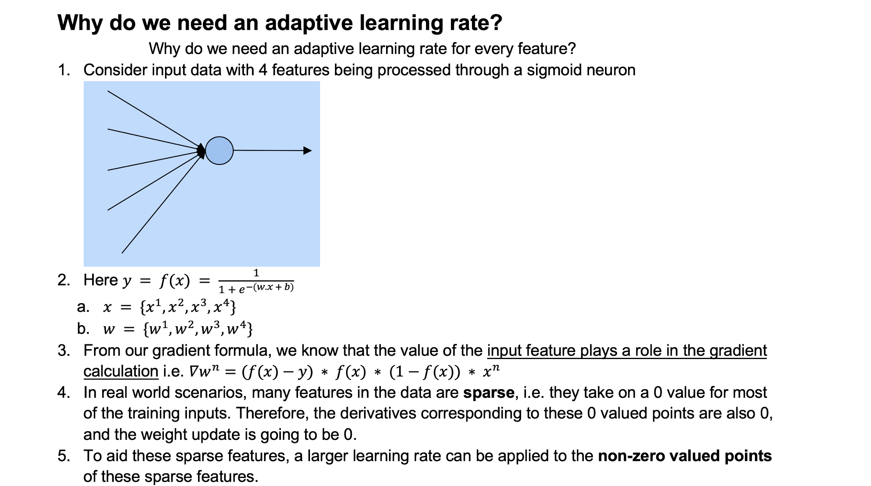

Slide 25
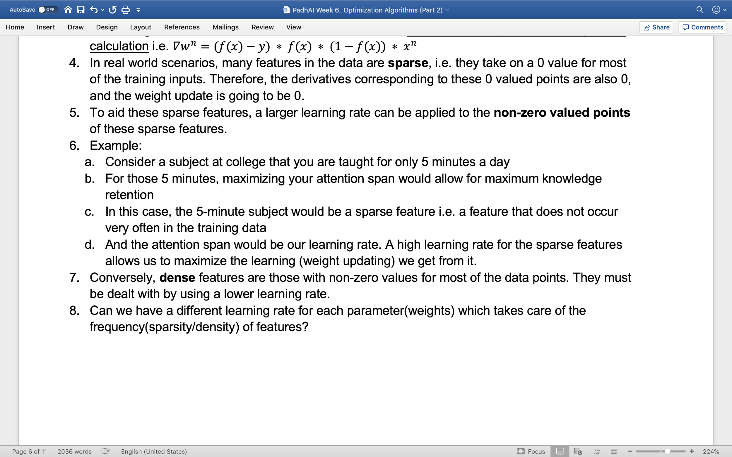

Slide 26
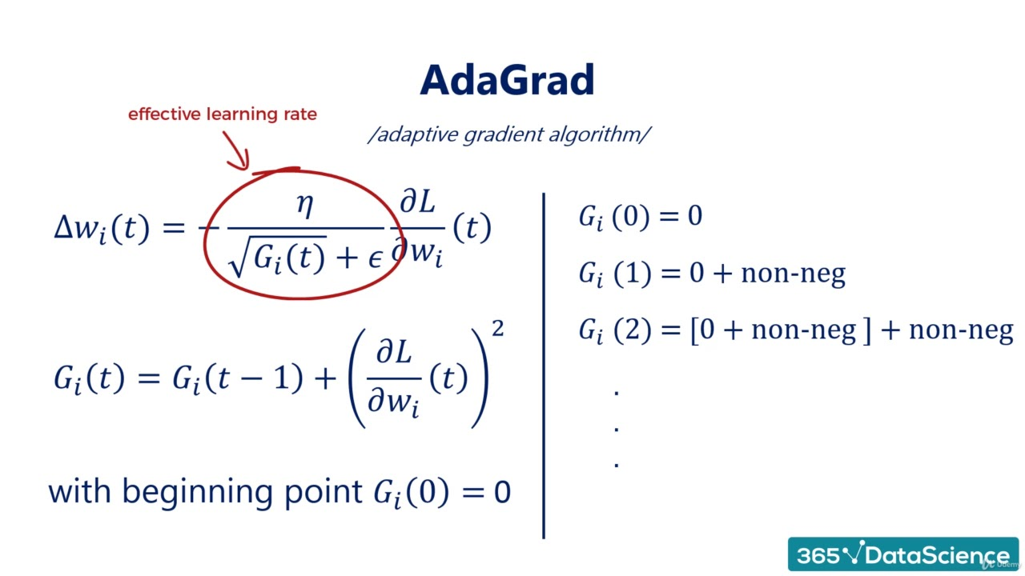
Adagrad - Adaptive Gradient

Slide 27
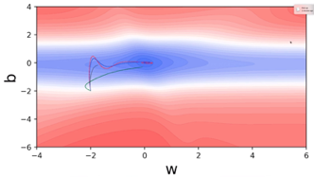
W is sparse feature here
B is dense feature

Slide 28
Adagrad Cont…..
1. Advantage: Parameters corresponding to sparse features get better updates
2. Disadvantage: The learning rate decays very aggressively as the denominator grows (not good for parameters corresponding to dense features)

Slide 29
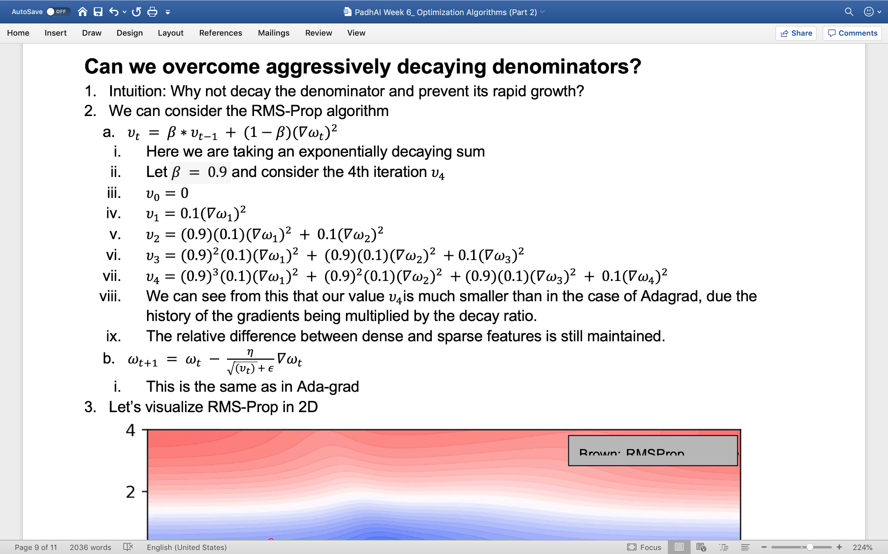
RMS Prop

Slide 30
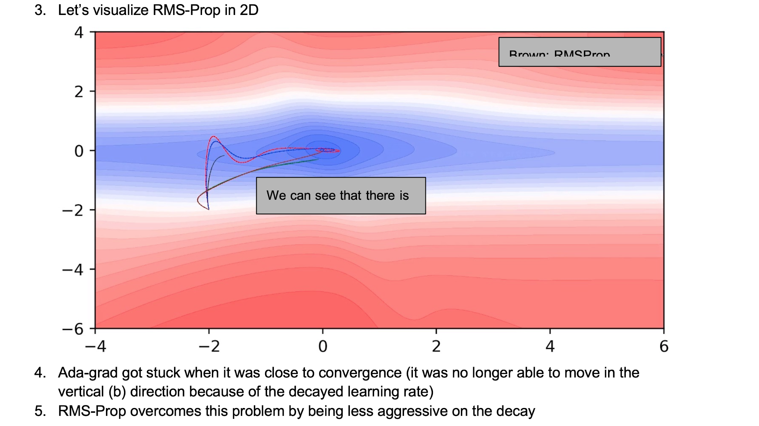

Slide 31
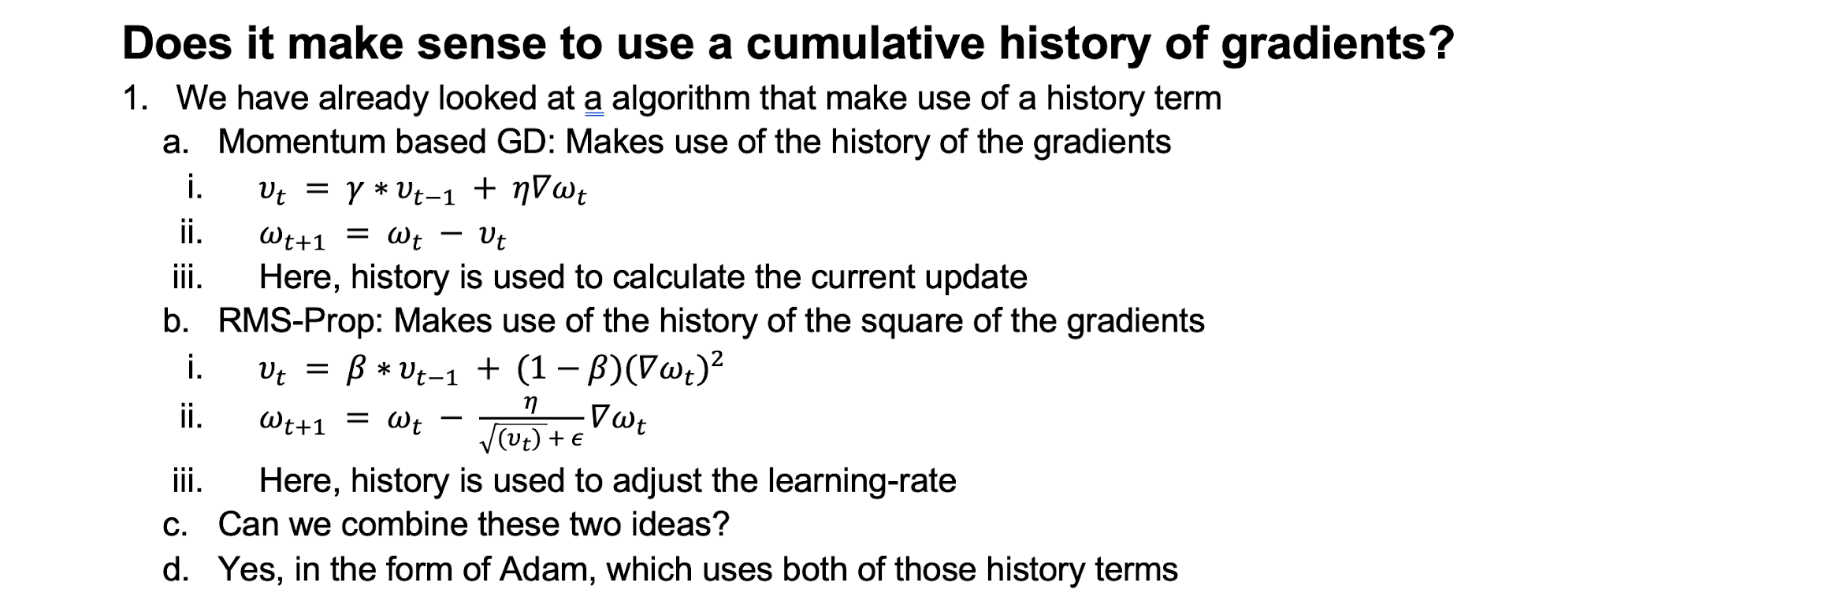
Adam optimizer

Slide 32
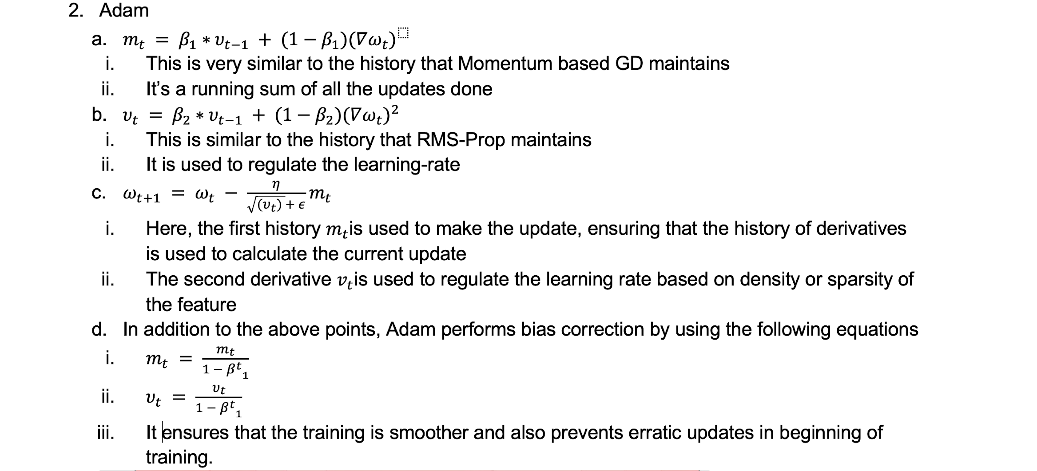

Slide 33
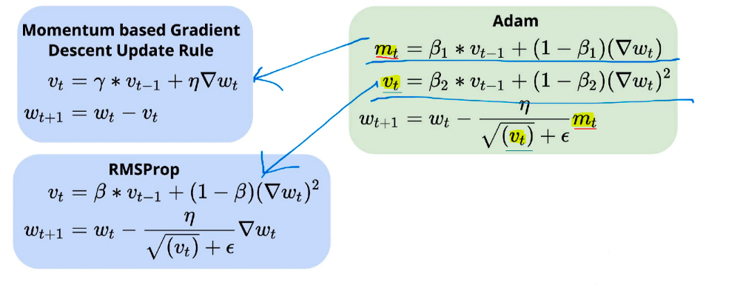

Slide 34
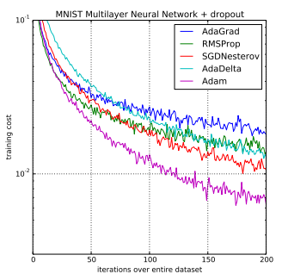

Slide 35
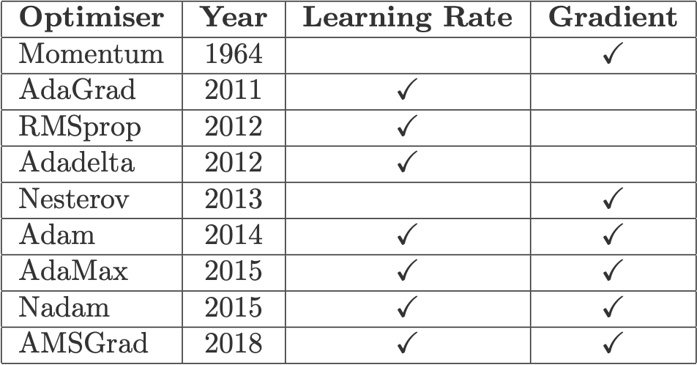

Slide 36
